Slide 1
Lifecycle Services Overview
Presented to:

Slide 2
Agenda
What is the Purpose of Lifecycle Services
System Diagnostic
Overview of UI and Functionality
Task Recorder and Business Process
License Calculator
Issue Search and Support

Slide 3
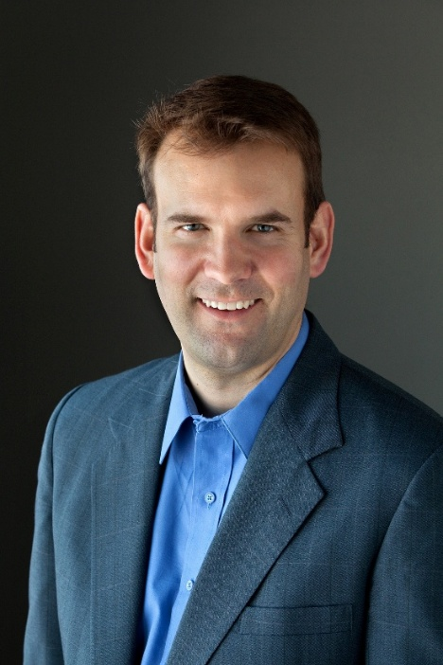
About Eric
Eric Newell
President – Stoneridge Software
Founder of Stoneridge Software – Microsoft partner with the most AX customers in MN, SD, ND, IA
Serve as Principal Project Manager conducting project reviews
Frequent presenter at Convergence and AXUG on project mgmt. best practices
13 year veteran at Microsoft – led North American Premier Field Engineering team for Dynamics AX
Dynamics CRM Technical Account Manager for several Fortune 500 customers
Convergence Presentations
Top 10 Implementation Pitfalls and How to Avoid Them 50 Tips for Managing Dynamics AX Implementations Performance Analyzer for Dynamics Premier Support for Dynamics Support & Services for Dynamics AX SQL for Dynamics

Slide 4
Purpose of Lifecycle Services
Provide toolset for customers and partners to improve deployment success
Utilize the cloud as a platform for these tools
Assist partners and customers in the sales cycle
Released on July 1 2013 – Monthly updates provided

Slide 5
How to Access Lifecycle Services
Go out to https://lcs.dynamics.com
Log in with CustomerSource credentials
Create a new project or join an existing project
Determine the project type – Learn, Pre-Sales or Implementation

Slide 6
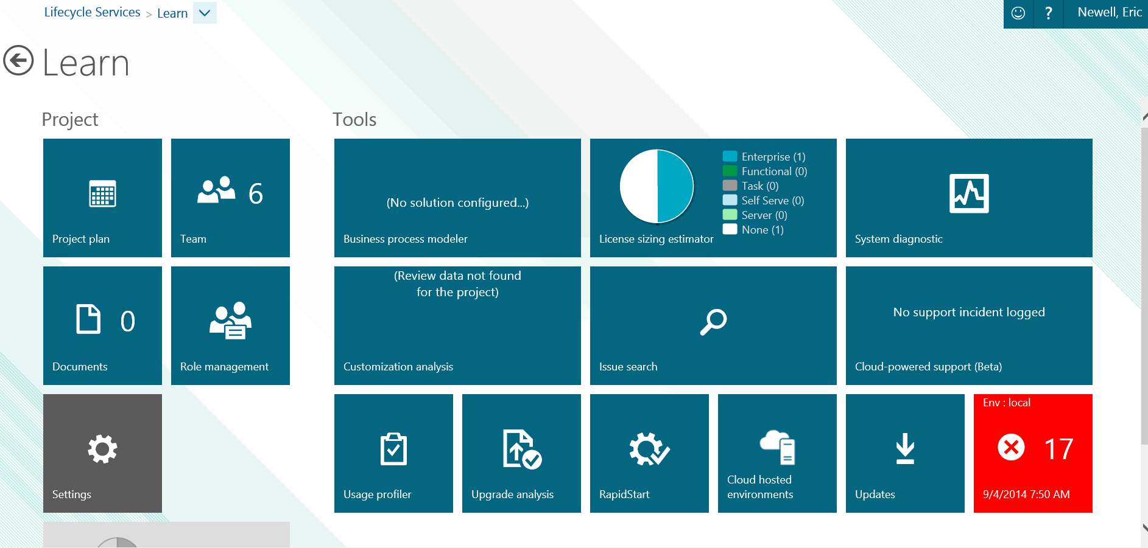
What’s in Lifecycle Services
Project Plan
Document Storage
Business Process Modeler
Customization Analysis
Upgrade Analysis
License Sizing Estimator
Issue Search
RapidStart
Cloud hosted environments
System Diagnostic
Support
Updates
Environment Sizing
Usage profiler

Slide 7
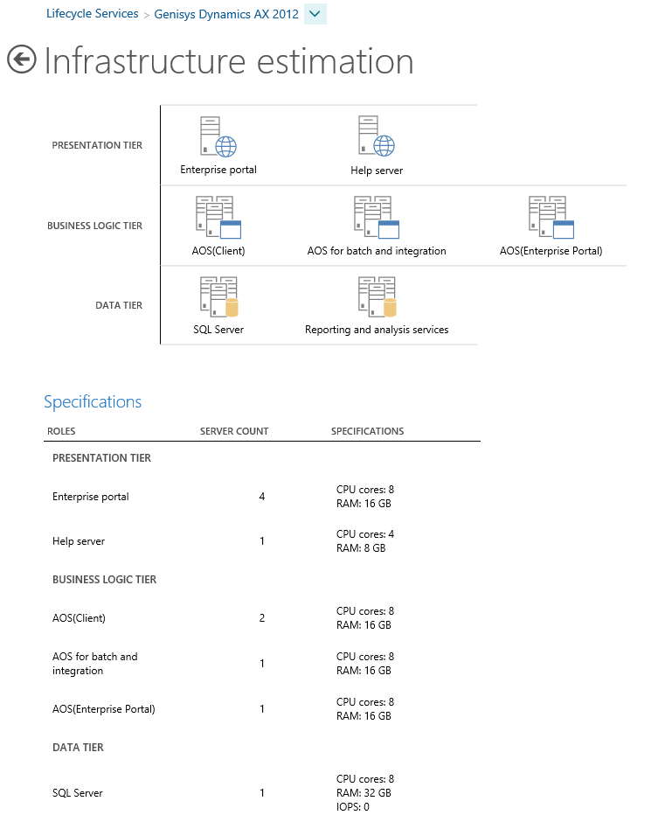
Infrastructure Estimation
Using Lifecycle Services you can see a visual representation of the number of servers needed for your company’s deployment
It is still a best practice to review this with a Technical Consultant, but it’s a great way to get started.

Slide 8
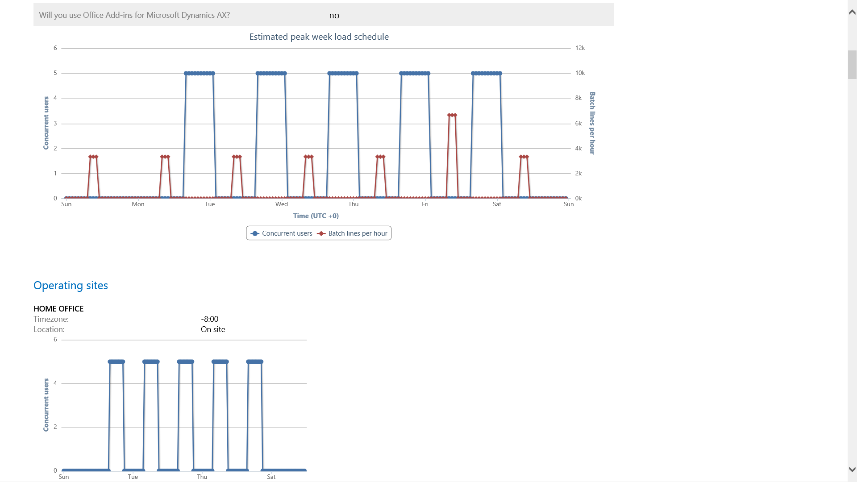
Usage Profiler
Result: estimated load schedule
Detailed usage patterns
Basis for performance support and infrastructure sizing
Notes:
Overview:
Easy to use method of data entry and collection
Peak load profile calculation

Slide 9
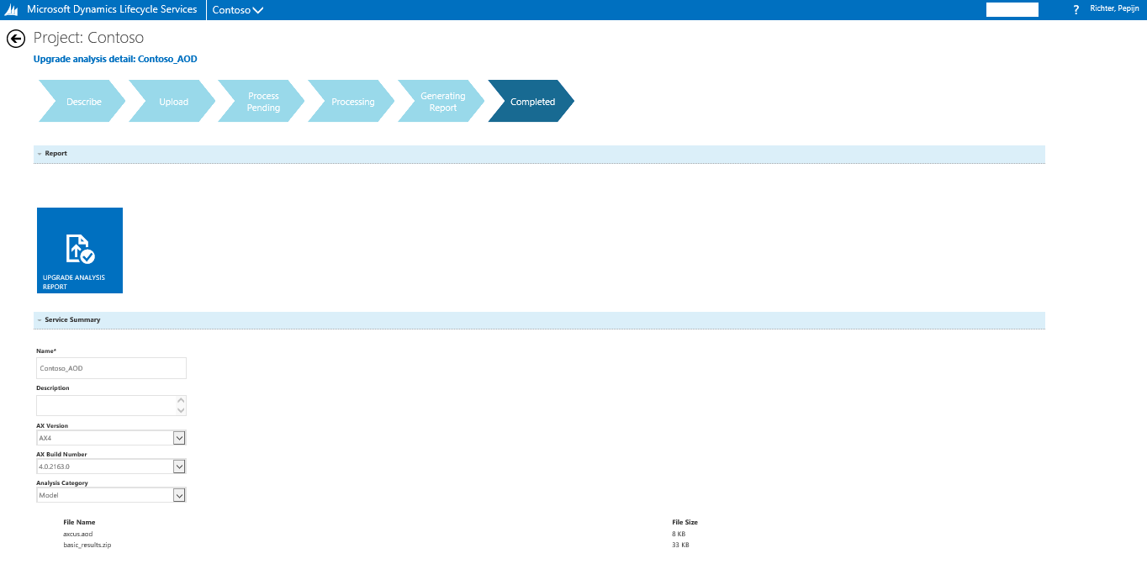
Upgrade Analysis Service (from 4 or 2009)
Process steps
Upgrade analysis report
Service summary
Notes:
Overview:
Analyze usage and customizations of your existing environment
Provides a starting point for your upgrade effort estimation

Slide 10
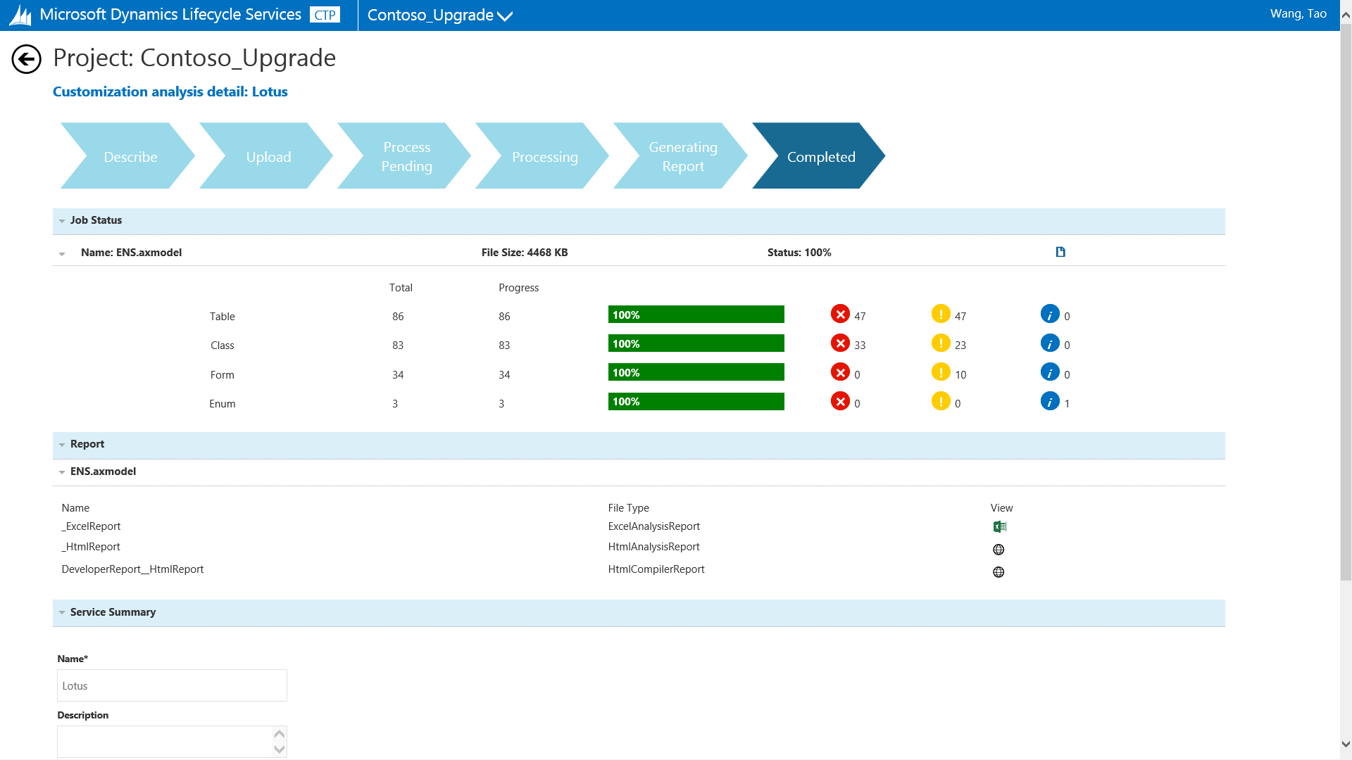
Customization Analysis Service
Process steps
Job status
Report
Notes:
Overview:
Analyze your customizations with a rule-based engine
Provides recommendations to improve customizations

Slide 11
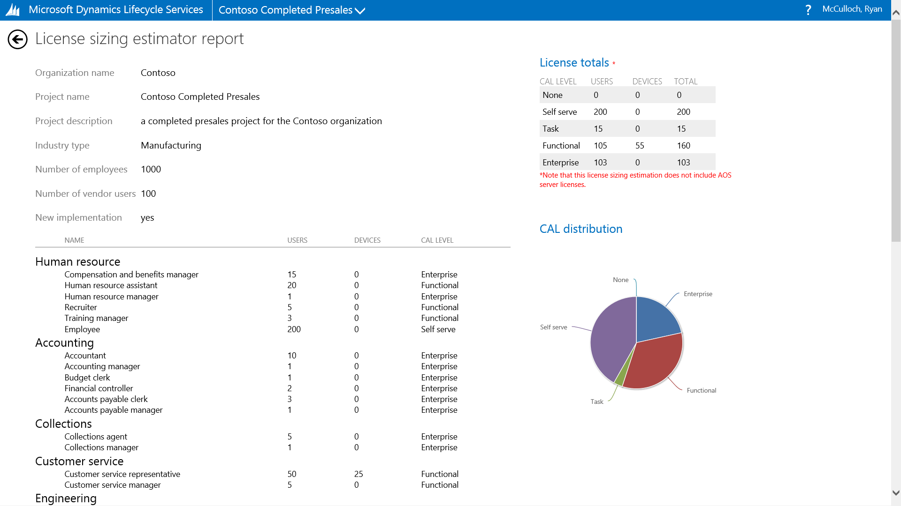
License Sizing Estimator
Overview of CAL needed
Overview roles
Visual overview of CAL distribution
Notes:
Overview:
Enables duty-level customization of roles
Automates the calculation of CAL types

Slide 12
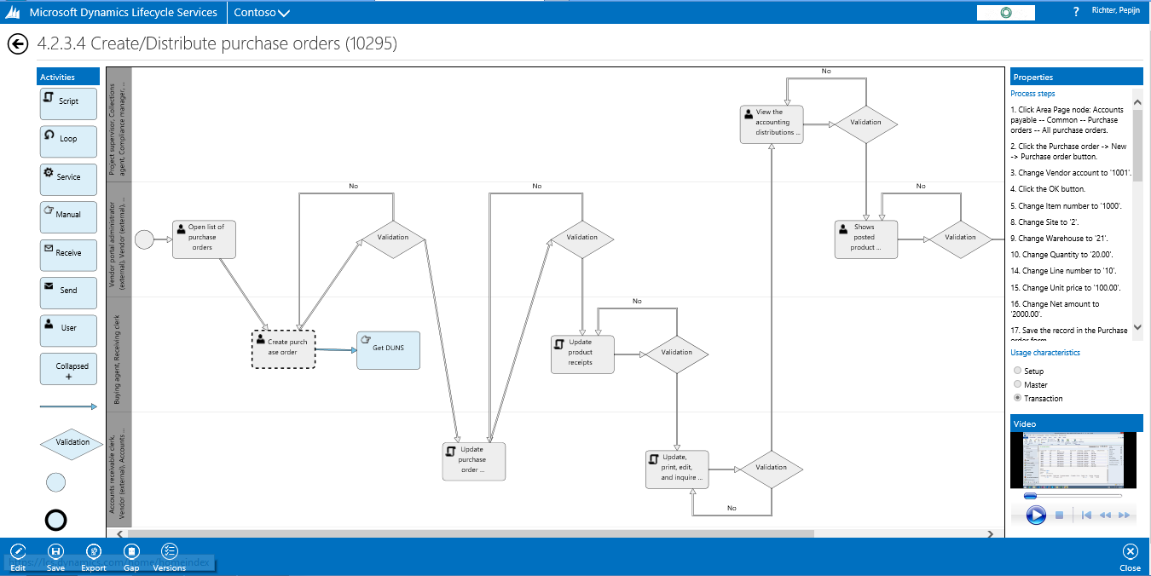
Business Process Modeler
Adaptable business process flowchart
Dynamics AX meta data for these process steps
Recording of the business process in Dynamics AX
High quality, quick analysis phase

Slide 13
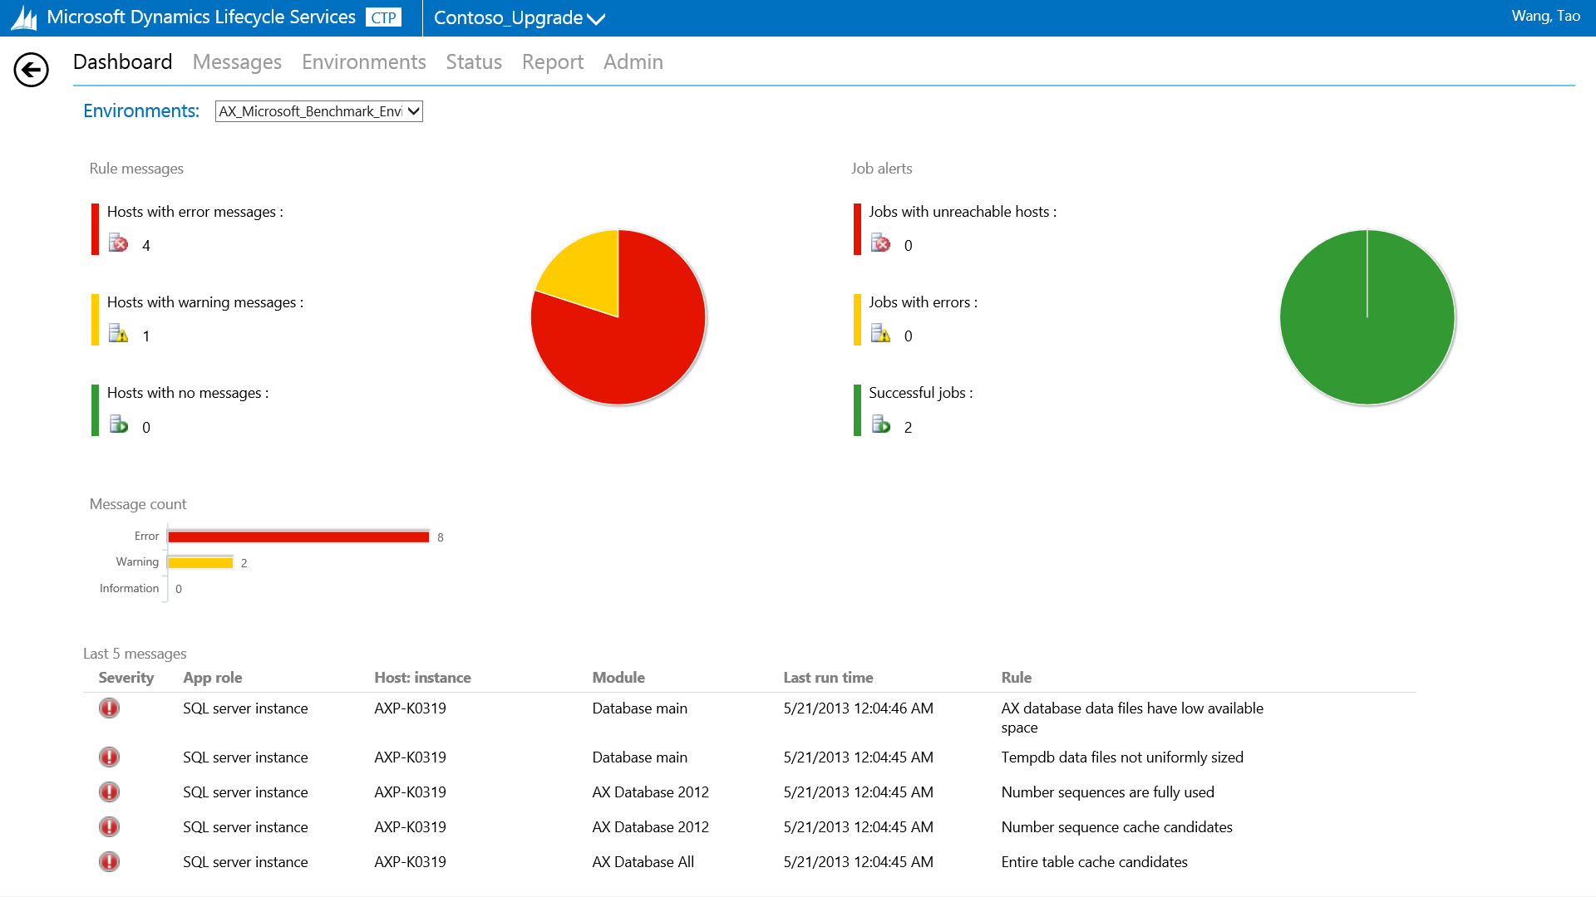
System Diagnostic
Navigation
Dashboard with most important violations for quick response
Overview of most recent messages
Notes:
Overview:
Analyze data collected from the system and check against set of rules
Provides a dashboard with violations

Slide 14
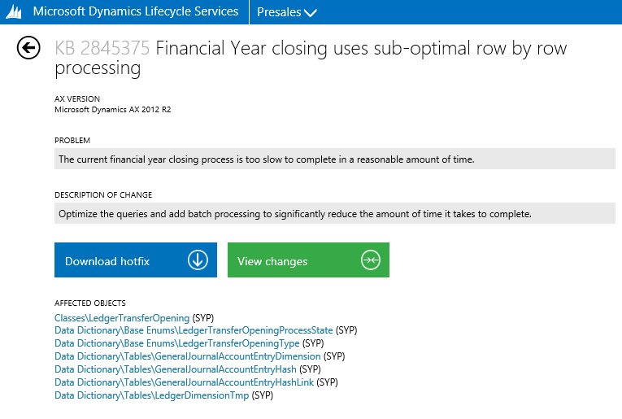
Issue Search
Search for hotfixes and reported issues online
Reduce time spend on finding hotfixes or potential workarounds
Download the hotfix directly from LCS
Identify and compare code objects affected by hotfix
Notes:
Overview:
Search a database of hotfixes, and reported/in-progress issues
Identify and compare code objects affected by hotfixes
View workaround solutions
Get notifications of changed state for active issues and for new fixes for functional areas

Slide 15
Lifecycle Services Resources
LCS Website: https://lcs.dynamics.com
LCS User Guide on TechNet: http://technet.microsoft.com/en-us/library/dn268616.aspx
LCS Blog: http://blogs.msdn.com/b/lcs
Stoneridge Software blog about LCS: http://www.stoneridgesoftware.com/category/lifecycle-services/
Murray Fife content – search Lifecycle Services and Murray Fife
Blog on Updates - https://medium.com/@satishthomas/staying-agile-with-dynamics-ax-updates-bca5a469d7b5

Slide 16
Open Forum / Questions?

